Slide 1

Perceptual factor and quality metrics for 3D meshes
Applications to compression
Guillaume Lavoué
Université de Lyon, INSA-Lyon
LIRIS UMR CNRS 5205
Technical Committee on Human Perception and Multimedia Computing
Notes:
Almost all mesh processing procedures cause some more or less visible changes in the appearance of objects represented by polygonal meshes. In many cases, such as mesh watermarking, simplification or lossy compression, the objective is to make the change in appearance negligible, or as small as possible, given some other constraints. Measuring the amount of distortion requires taking into account the final purpose of the data. In many applications, the final consumer of the data is a human observer, and therefore the perceptibility of the introduced appearance change by a human observer should be the criterion that is taken into account when designing and configuring the processing algorithms.In this review, we discuss the existing comparison metrics for static and dynamic (animated) triangle meshes. We describe the concepts used in perception-oriented metrics used for 2D image comparison, and we show how these concepts are employed in existing 3D mesh metrics. We describe the character of subjective data used for evaluation of mesh metrics and provide comparison results identifying the advantages and drawbacks of each method. Finally, we also discuss employing the perception-correlated metrics in perception-oriented mesh processing algorithms.

Slide 2





A joint work with:
Libor Váša - University of West Bohemia, Czech Republic
Massimiliano Corsini - ISTI-CNR, Italy
Mohamed-Chaker Larabi - XLIM-SIC, Poitiers
Oldřich Petřík - University of West Bohemia, Czech Republic
Kai Wang - Gipsa-Lab, Grenoble
Eurographics 2012
State of The Art

Slide 3
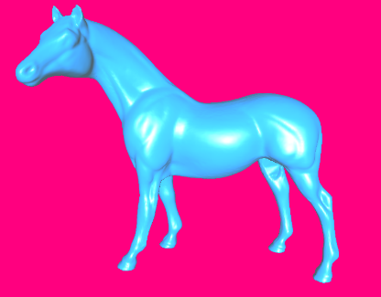


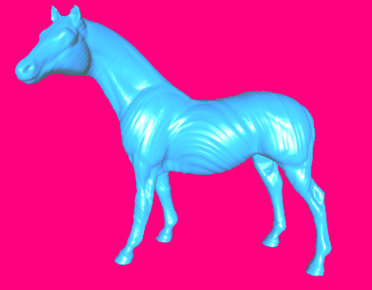
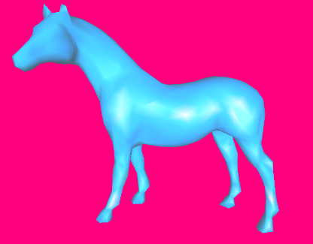

Motivation
Watermarking
Wang et al. 2011
Smoothing
Taubin, 2000
Original
Watermarking
Cho et al. 2006
Simplification
Lindstrom, Turk 2000
Noise addition
Same Max Root Mean Square Error (1.05 × 10⁻³)
Motivation
Notes:
Classical metrics for measuring error between 3D meshes (like the Root Mean Square Error) do not correlate with the human perception.

Slide 4
Motivation
Perceptual metrics needed
Perceptual comparison necessary when
  Target is a human viewer
  Need to decide which algorithm to use
  Need to configure an algorithm to provide optimal results
Compare results of
  Mesh watermarking
  Mesh compression
  Mesh simplification
  …
Motivation
Notes:
Hence there is a need for more « perceptual » metrics for driving and evaluating mesh processing algorithms.

Slide 5
Outline
  Several mechanisms from perception
  Quality metrics
  Evaluation and Databases
  Applications
Motivation – Perception – Metrics – Evaluation – Applications

Slide 6
Outline
  Several mechanisms from perception
    Contrast Sensitivity Function
    Visual masking
    Eye fixation - Saliency
  Quality metrics
  Evaluation and Databases
  Applications
Motivation – Perception – Metrics – Evaluation – Applications

Slide 7

Contrast Sensitivity Function
The spatial frequency of the distortion is important
[Campbell and Robson, 1968]
Contrast
Spatial frequency
Motivation – Perception – Metrics – Evaluation – Applications
Notes:
Our visual system is sensitive to the frequency and contrast of the signal; it acts as a band-pass filter with a peak sensitivity between 4 and 6 cpd and a cut-off at 30 cpd.

Slide 8
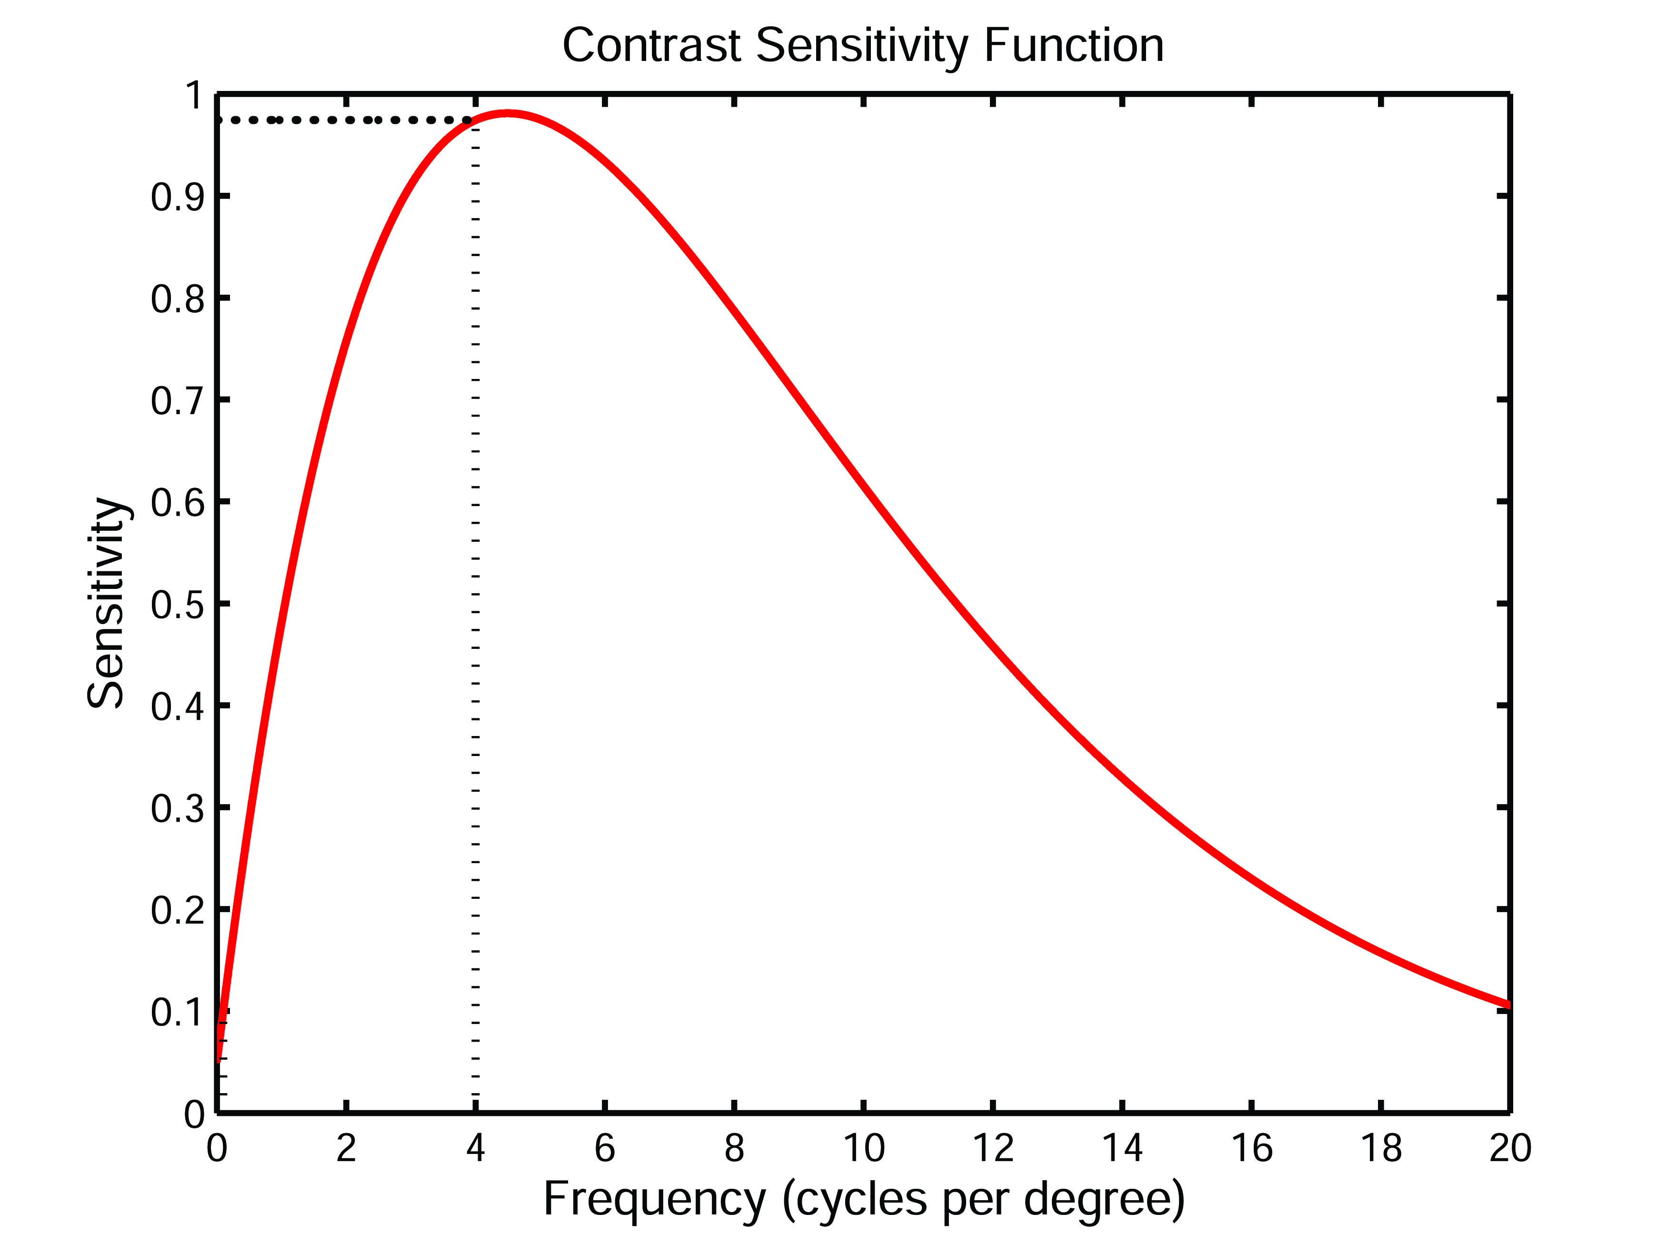
Contrast Sensitivity Function
HVS has bandpass-like frequency sensitivity
CSF(4.0 cpd) = 0.97
CSF(0.1 cpd) = 0.10
Motivation – Perception – Metrics – Evaluation – Applications
Notes:
Our visual system is sensitive to the frequency and contrast of the signal; it acts as a band-pass filter with a peak sensitivity between 4 and 6 cpd and a cut-off at 30 cpd.

Slide 9
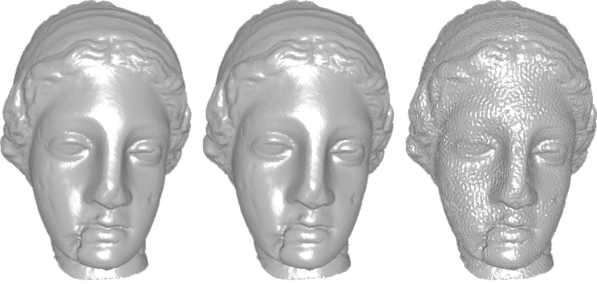
Contrast Sensitivity Function
Illustration for 3D models
Low frequency modifications
High frequency modifications
0.1 cpd
4 cpd
Same MRMS
Motivation – Perception – Metrics – Evaluation – Applications
Notes:
This sensitivity of the human visual system to the frequency can be applied for 3D geometric signals.
A low frequency modification is much less visible than a high frequency one.

Slide 10
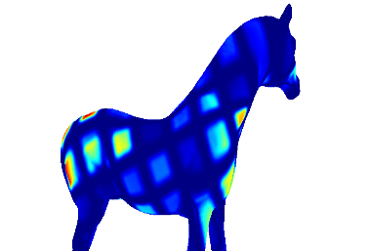
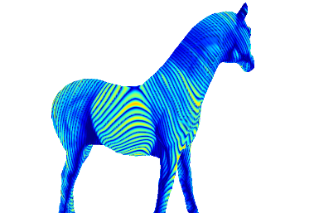
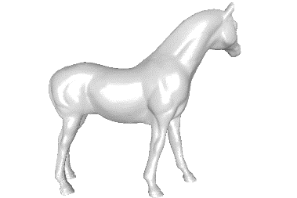
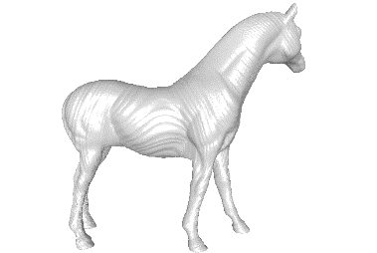
Contrast Sensitivity Function
How to use it? Low frequency distortions are less visible than high frequency ones.
Better than
[Wang et al. 2011]
[Cho et al. 2006]
10
Motivation – Perception – Metrics – Evaluation – Applications
Notes:
Some watermarking schemes make use of this principle.
[Wang et al. 2011] insert the watermark by introducing low frequency modifications, making it almost invisible.

Slide 11
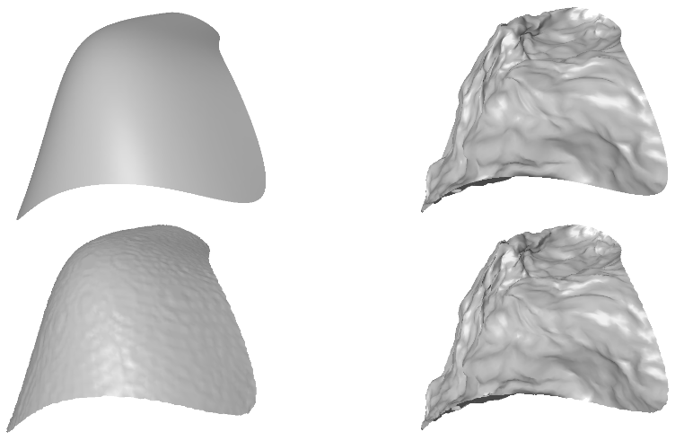
Visual Masking
Visual Masking defines the reduction in the visibility of one stimulus due to the simultaneous presence of another
Geometric quantization
Geometric quantization
Motivation – Perception – Metrics – Evaluation – Applications
Notes:
Another well known perceptual principle is the visual masking.
If we apply the same level of quantization on a smooth and a rough surfaces, the geometric artefacts will be less visible on the rough one.

Slide 12
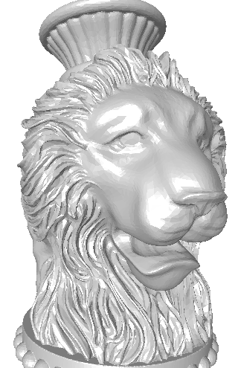
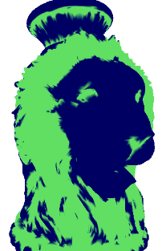


Visual Masking
How to use it? Distortions in rough regions are less visible than in smooth ones.
Rough region detection
Distortion on smooth regions
Distortion on rough regions
Motivation – Perception – Metrics – Evaluation – Applications
Notes:
This principle can be applied to hide geometric artefacts,

Slide 13
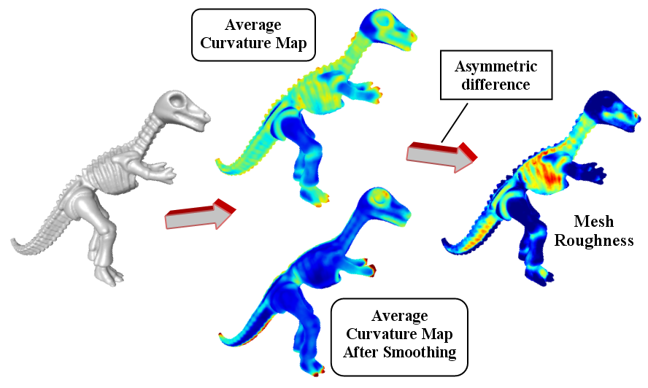
Utilisation du masquage
Visual Masking
Example of roughness estimator
[Lavoué 2009]
Motivation – Perception – Metrics – Evaluation – Applications
Notes:
Some algorithms have been introduced to classify regions into rough and smooth.

Slide 14
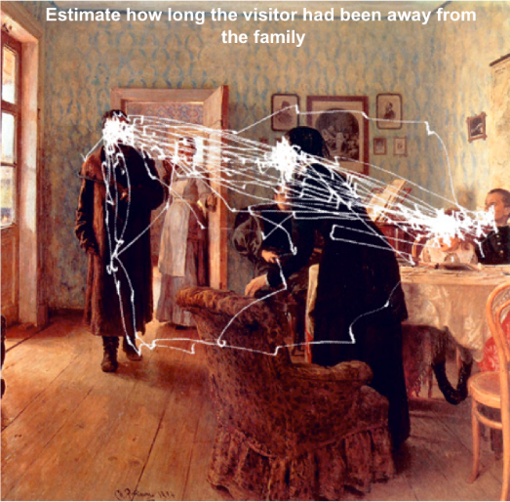
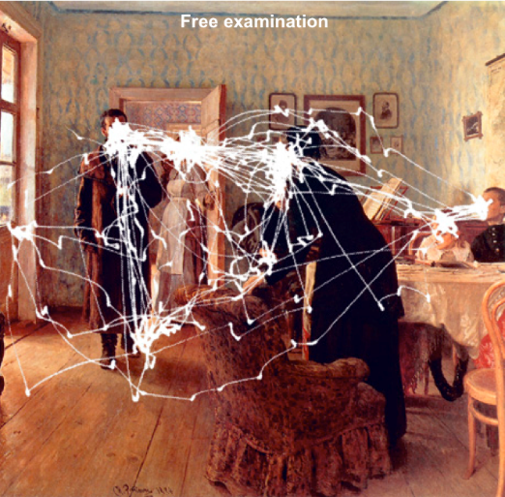
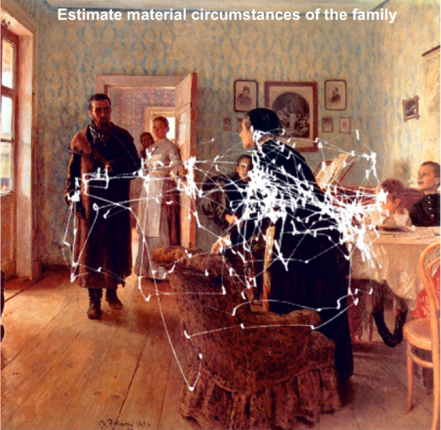
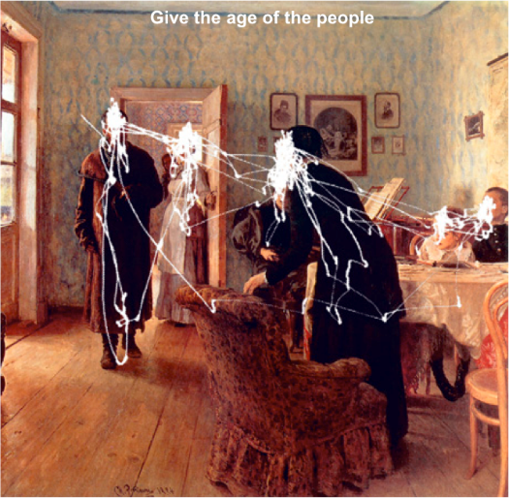

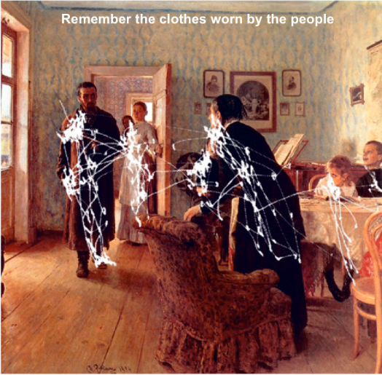
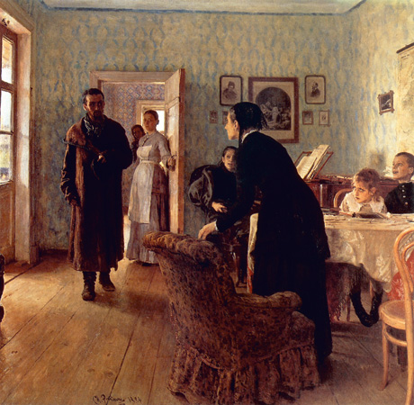
Eye fixation - Saliency
Saliency and eye fixation refer to the visual attention of the observer
[Yarbus, 1967]
Yarbus (1967) conducted a pioneering experiment.
He showed Ilya Repin’s painting to several observers and assigned to them different viewing tasks.
Results show that depending on the assigned tasks the saccades and the fixations are different.
Motivation – Perception – Metrics – Evaluation – Applications
Notes:
Another aspect of human perception that has been widely explored and used in the last few years is related to visual saliency. This property is fundamental in the exploration of the surrounding visual world. Analysis of visual attention is considered a very important element in human perception because of its suitability in various computer vision applications. Eye tracking is the main way to study and understand this property. One of the most famous and often-cited studies was performed by Yarbus in the 60s

Slide 15
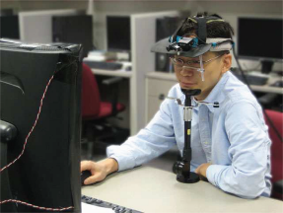
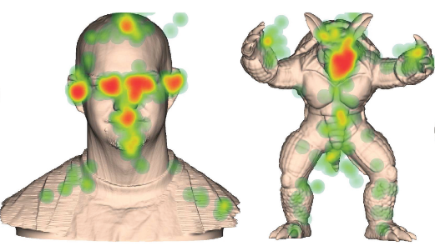
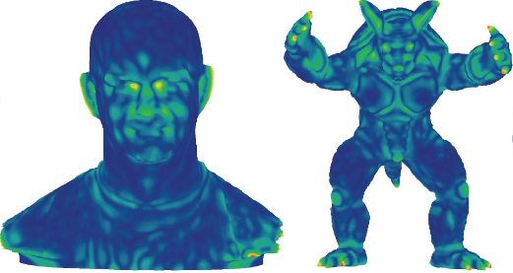
Eye fixation - Saliency
Saliency and eye fixation, illustrations for 3D meshes
[Kim et al. 2010]
Automatic saliency computation [Lee et al. 2005]
Motivation – Perception – Metrics – Evaluation – Applications
Notes:
The saliency has been studied for 3D meshes. Some authors have made eye tracking experiments with 3D meshes and others have proposed some automatic saliency estimators. These estimators try to mimic the human visual system in order to reproduce the saliency property on the 3D mesh.

Slide 16
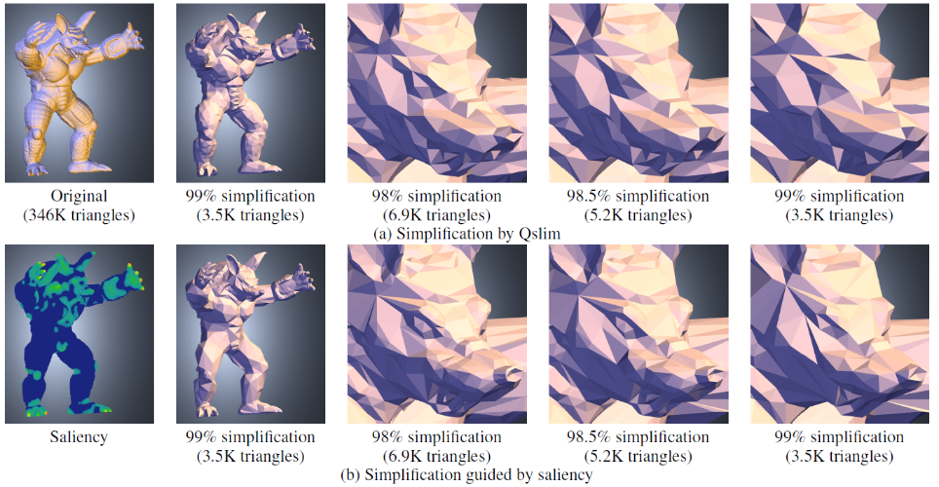
Perceptual mechanisms: Saliency
Example of use:
[Lee et al. 2005]
Motivation – Perception – Metrics – Evaluation – Applications
Notes:
Applications of saliency include perceptually-based simplification.

Slide 17
Outline
  Several mechanisms from perception
  Quality metrics
  Evaluation and Databases
  Applications
Motivation – Perception – Metrics – Evaluation – Applications

Slide 18
Outline
  Several mechanisms from perception
  Quality metrics
    Image
    Static mesh
    Dynamic mesh
  Evaluation and Databases
  Applications
Motivation – Perception – Metrics – Evaluation – Applications

Slide 19
Image Quality metrics
Standard IQA model:
[Daly, 1994][Lubin, 1995][...]
  Motivation
    Simulate relevant early HVS components
  Key features
    Channel decomposition → linear frequency/orientation transforms
    Frequency weighting → contrast sensitivity function
    Masking → intra/inter channel interaction
Motivation – Perception – Metrics – Evaluation – Applications
Notes:
We present here a generic bloc-diagram of perceptual image quality metrics. A perceptual decomposition (multi-channel decomposition) is applied in order to take into account the spatial-frequency sensitivity of the HVS. The most used decompositions are those of Daly~\cite{DAL-94}, Lubin~\cite{LUB-93} and Watson~\cite{WAT-87} and the output of this block results in a set of luminance images. For each of these images, a local contrast is calculated at each point. The masking block aims to exploit the masking abilities of the HVS described in the previous slides. Its role is to specify for each sub-band and for each point the variation of the visibility threshold when the masking effect is taken into account. These values allow one to keep only the errors located above the threshold and thus contributing to the estimation of the final quality. Finally, the pooling stage is designed to reduce this dimensionality of the computed data. Generally, the pooling is performed in two steps. The first where the error images spread across all frequency channels are combined into a single error image (the frequency pooling). The second step is dedicated to the spatial pooling and is to combine the spatial errors in a final measure that represents the score given by the algorithm to the impaired image.

Slide 20
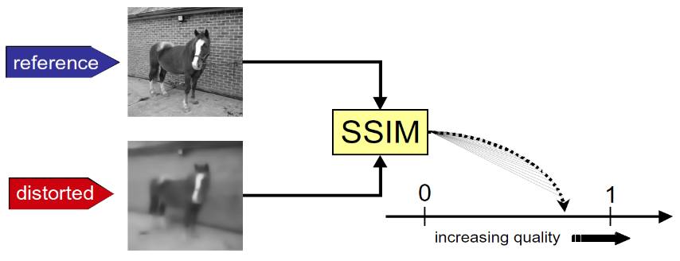
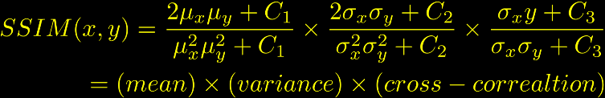
Image Quality metrics
Simpler models relying on simple signal fidelity measure
[Wang et al., 2004]
Motivation – Perception – Metrics – Evaluation – Applications
Notes:
Here is an example of a well known signal-oriented metric (more simple than perceptual metrics that try to mimic the human visual system),
Local statistics of luminance are compared block by block and then pooled to obtain one single quality index.

Slide 21
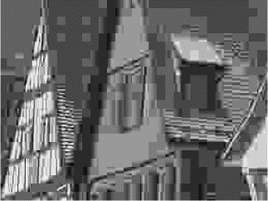

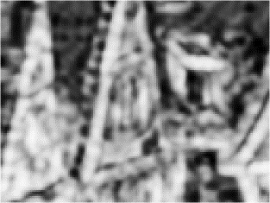
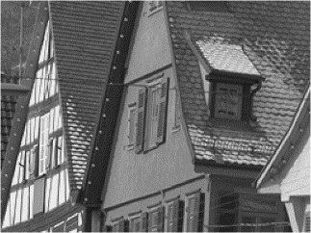
Image Quality metrics
x
Local distortion
Distorted image
y
Local Distortion Map
Spatial pooling
(simple average over pixels)
Global Distortion Score
Original image
Motivation – Perception – Metrics – Evaluation – Applications
Notes:
Here is an example of a well known signal-oriented metric (more simple than perceptual metrics that try to mimic the human visual systeml),
Local statistics of luminance are compared block by block and then pooled to obtain one single quality index.

Slide 22
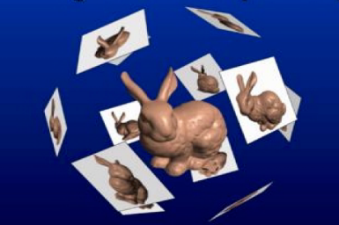
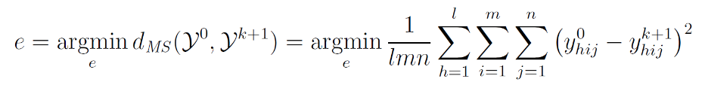
Quality metrics for static meshes
A lot of applications consider 2D metrics
  Rendering [Reddy, 1997][Bolin, Meyer, 1998][Dumont et al., 2004]
  Simplification [Lindstrom, Turk, 2000][Qu, Meyer, 2008]
They use a set of 2D views to drive simplification
Edge is collapsed according to image-based evaluation:
Motivation – Perception – Metrics – Evaluation – Applications
Notes:
A metric for comparing 3D meshes can work directly on the 3D object or in image-space. First, we give a brief panoramic of the characteristics of the metrics that work
In image-space, that we call image-based metrics. The main application was in the mesh simplification and in rendering.
An example is the work of Lindstrom et al. The simplification is achieved through edge collapse, the cost to collapse an edge
is related to the impact on the different views of the 3D model.
In the original proposal, a simple RMS measure is used to evaluate the cost
of collapse an edge. Then, a simplified version of the Sarnoff model has been employed
in the same framework by Lindstrom.
The results are presented in his PhD thesis about image-driven mesh simplification.

Slide 23


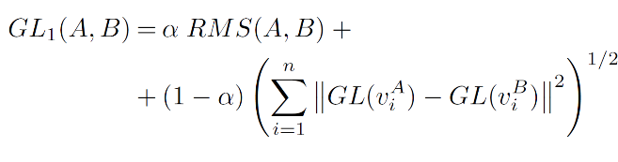
Quality metrics for static meshes
Perceptual metrics for static and dynamic triangle meshes
Simple geometric distances:
  Hausdorff distance.
  Root Mean Square error:
  Combination of mean error with Geometric Laplacian
[Karni, Gotsman, 2000] [Sorkine et al., 2003]
Motivation – Perception – Metrics – Evaluation – Applications
Notes:
In contrast to Image-based metrics, there exist also model-based metrics that work directly on the 3D geometry.
Some authors just consider the Hausdorff distance combined with a difference of Laplacian.

Slide 24
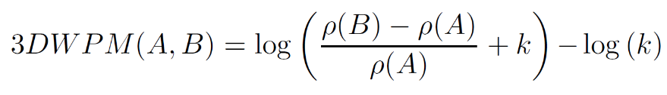
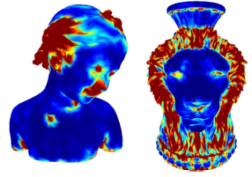

Quality metrics for static meshes
Perceptual metrics for static and dynamic triangle meshes
Global differences of roughness
[Drelie Gelasca et al. and Corsini et al., 2005]
Roughness obtain through:
Multi-scale dihedral angles analysis.
Differences between the input model and a laplacian smooth of the mesh.
[Wang et al. 2012]
Roughness obtain through:
Laplacian of Gaussian curvature
Motivation – Perception – Metrics – Evaluation – Applications
Notes:
Drelie Gelasca et al. and Corsini et al. proposed to evaluate the
perceived visual impairment with the roughness changes. Roughness changes
influence the shading, at the end, and hence more high is the roughness changes,
more high is the probability to note difference between the original and the processed
model. Only the relative increment is evaluated (see the denominator)
to account for the masking effects of roughness.
As it is possible to note the roughness is summed up over all the model, hence
such evaluation is global and it is not able to work well if only a part of the object
is modified. This limit can be removed by re-formulating the evaluation.
Two ways have been proposed to evaluate the roughness, using dihedral angles (1-ring, 2-ring, and so on)
and using the difference between a smoothed version of the model and the model itself.

Slide 25
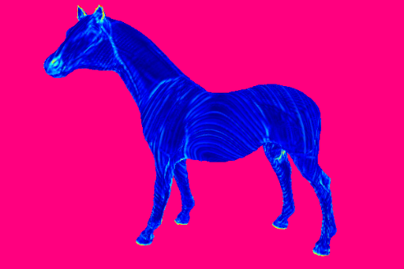
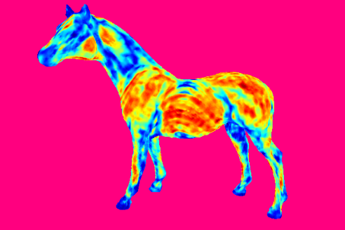

Quality metrics for static meshes
Local curvature statistics
MSDM [Lavoué et al. 2006]
MSDM2 [Lavoué 2011]
[Torkhani et al. 2012]
Distorted model
Local differences
of statistics
Matching
Local Distortion Map
Spatial pooling
Original model
Global Distortion Score
Motivation – Perception – Metrics – Evaluation – Applications
Notes:
The Mesh Structural Distortion Measure, usually abbreviated with MSDM
has been proposed by Lavoue et al. in 2006. This measure follow
the idea of the Structural Image Similarity metric by Wang et al. , 2004.
It considers local differences of curvature statistics and then apply a pooling strategy to obtain one single quality score.

Slide 26



Quality metrics for static meshes
Perceptual metrics for static and dynamic triangle meshes
Local dihedral angle differences
[Vasa and Rus 2012]
  Signed dihedral angle per face:
  Masking modulation:
  Global pooling:
  Triangle visibility weighting
Motivation – Perception – Metrics – Evaluation – Applications
Notes:
Vasa et al. proposed a metric based on differences of dihedral angles.

Slide 27
Quality metrics for dynamic meshes
Perceptual metrics for static and dynamic triangle meshes
Metrics based on static mesh comparison
  PSNR, MSE, Hausdorff, …
  Inherit all problems from static case
  Cannot detect temporal artifacts
  Pioneering work on dynamic mesh compression (Lengyel 1999):
“[observed phenomena] show that SNR is not an effective measure of coding quality. More work is needed to determine a measure with more correlation with perceived quality.”
Motivation – Perception – Metrics – Evaluation – Applications
Notes:
Previous metrics are for static meshes.
Some metrics have also been introduced to measure the visual quality of dynamic meshes (i.e. mesh sequences)

Slide 28



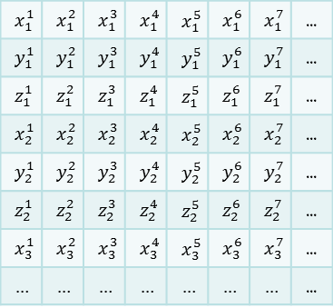
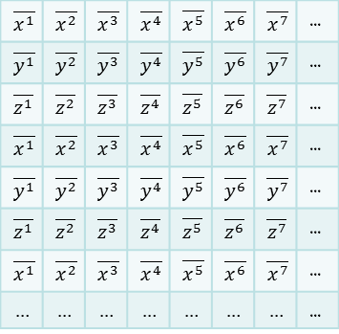
Quality metrics for dynamic meshes
KG error [Karni and Gotsman, 2004]
  Most common
  No perceptual correlation
  No detection of any kinds of perceptual artifacts
  In reality only a normalised version of RMSE
 |  |  |  |  |  |  | ...
 |  |  |  |  |  |  | ...
 |  |  |  |  |  |  | ...
 |  |  |  |  |  |  | ...
 |  |  |  |  |  |  | ...
 |  |  |  |  |  |  | ...
 |  |  |  |  |  |  | ...
 |  |  |  |  |  |  | ...
 |  |  |  |  |  |  | ...
 |  |  |  |  |  |  | ...
 |  |  |  |  |  |  | ...
 |  |  |  |  |  |  | ...
 |  |  |  |  |  |  | ...
 |  |  |  |  |  |  | ...
 |  |  |  |  |  |  | ...
 |  |  |  |  |  |  | ...
Motivation – Perception – Metrics – Evaluation – Applications
Notes:
A metric used quite commonly in dynamic mesh compression is the KG error, proposed by Karni and Gotsman. The metric is designed specifically for animated triangle meshes.
It works on matrices describing original and distorted meshes, where columns of the matrices describe trajectories of respective vertices of the animation.

Slide 29


Quality metrics for dynamic meshes
Perceptual metrics for static and dynamic triangle meshes
Ribbon error [Jang et al., 2004] (Da error)
  Ribbons formed by error vectors
  Sums areas of all ribbons over all vertices/frames
  Works with each XYZ coordinate separately
X coordinate
X coordinate
time
time
Motivation – Perception – Metrics – Evaluation – Applications
Notes:
Another metric designed specifically for animated meshes has been proposed by Jang et al.~\cite{JKJHW04}. This metric works on ribbons formed by error vectors in subsequent frames. An error vector is a vector connecting the original and distorted position of a particular vertex in a particular frame. The $D_{a}$ error metric works on error vectors projected into coordinate axes, taking always only a single coordinate into account. The error vectors associated with a particular vertex in two subsequent frames form a ribbon-like structure in 2D space (coordinate + time), and the metric computes the area of this ribbon and uses it as a contribution of the particular vertex to the overall error. The metric obtains the contributions from all the vertices and all pairs of subsequent frames of the animation, and finally normalizes the result.

Slide 30
STED error [Váša and Skala, 2011]
Quality metrics for dynamic meshes
Perceptual metrics for static and dynamic triangle meshes
  Spatio-Temporal Edge Difference
Temporal part
Spatial part
  Length of temporal edges
    Connects vertex in two subsequent frames
  Difference of the length
  Weighted inversely by original vertex speed
    Temporal artifacts more visible in slow moving areas
  Relative edge lengths REL
  Std. deviation of REL within topological windows around vertices
  Sum over all frames/vertices
time
Motivation – Perception – Metrics – Evaluation – Applications
Notes:
The first, and so far the only attempt at a perceptual metric for dynamic meshes is the STED error proposed by V\'{a}\v{s}a and Skala \cite{VS11}. It is based on the observation that perception of distortion is related to local and relative changes rather than global and absolute changes of vertex positions. The metric works on edges as basic primitives, and computes the relative change in length for each edge of the mesh in each frame of the animation. Subsequently, for each vertex, the standard deviation of relative edge lengths is computed within a topological neighbourhood of the vertex. This deviation is used as a contribution of the vertex to the spatial part of the error metric, assuming that high local deviation relates to higher local distortion and thus higher perceived error.The metric also attempts to capture temporal artifacts by working with virtual temporal edges: that is, edges that connect position of a vertex in two subsequent frames. The difference between original temporal edge length and distorted temporal edge length is then again used as a contribution to the temporal part of the error metric. The metric normalises the contributions of temporal edges using the speed of the vertex in a local temporal window, thus taking into account that "shaking" artifacts are more noticeable in areas that are static or moving slowly.

Slide 31
Outline
  Several mechanisms from perception
  Quality metrics
  Evaluation and Databases
  Applications
Motivation – Perception – Metrics – Evaluation – Applications

Slide 32
Outline
  Several mechanisms from perception
  Quality metrics
  Evaluation and Databases
    What is a subjective test
    Existing databases
    Evaluation results
  Applications
Motivation – Perception – Metrics – Evaluation – Applications

Slide 33
What is a subjective test?
Perceptual metrics for static and dynamic triangle meshes
Perceptual metrics aim at predicting the visual quality of a 3D (or 3D+t) model.
Subjective visual quality can also be assessed directly by computing Mean Opinion Scores (MOS).
Average quality as appreciated
by observers
Excellent way to evaluate perceptual metrics
Obtained through subjective evaluation
Motivation – Perception – Metrics – Evaluation – Applications
Notes:
Perceptual metrics presented in previous slides aim at predicting the visual quality of a 3D (or 3D+t) model as perceived by a human observer. This perceived quality can also be directly and quantitatively assessed by means of subjective tests. In such tests, human observers directly give their opinion or some ratings about the perceived quality of a corpus of distorted models; a mean opinion score (MOS) is then computed for each distorted object reflecting its average quality as appreciated by the observers. The correlation between these subjective mean opinion scores and the objective scores computed by the metrics provides an excellent indicator of the performance of these metrics and a very good way to evaluate them quantitatively.

Slide 34



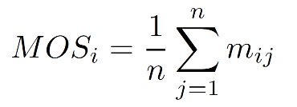
Subjective test - basics
Perceptual metrics for static and dynamic triangle meshes
A database is constructed.
(reference objects + distorted versions)
Object are rated by observers.
Mean Opinion Scores are computed.
Normalization, filtering of the MOS.
Score given by the j^{th} subject to the i^{th} object
Mean opinion score for the i^{th} object
Number of subjects
Motivation – Perception – Metrics – Evaluation – Applications
Notes:
Practically and whatever the type of media (image, video or 3D models), the design of a subjective test is composed of the following steps:
- A database is constructed containing different objects (reference objects and distorted versions).
The subjective experiment is conducted where human observers give their opinion or some ratings about the perceived distortions of the database objects. A mean opinion score (MOS) is then computed for each distorted object of the corpus
Since some observers may have used the rating scale differently, a normalization of the MOS values is usually conducted, followed by a filtering of possible outlier. The reliability of the MOS may also be checked by computing the $95\%$ confidence intervals or the intraclass correlation coefficient.

Slide 35
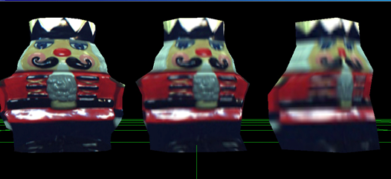
Subjective test – an example
[Pan et al., 2005]
Dataset:
90 textured models
5 objects * 6 mesh LoD *3 texture LoD
20 observers.
Interaction:
Rotation speed control
Objectives:
1) Studying the influence of texture and resolution on the visual appearance.
2) Evaluation of their perceptual metric.
Best case Worst case
Stimulus to rate
very poor (1), poor (2), fair (3), good (4), very good (5)
Motivation – Perception – Metrics – Evaluation – Applications
Notes:
Here is an example of subjective tests conducted by Pan et al. 2005.

Slide 36
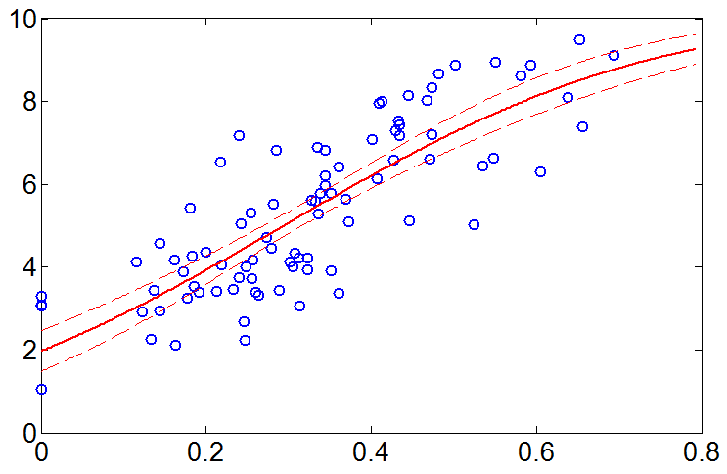
Performance evaluation
Correlation analysis between MOS x and metric values y
    Pearson Linear Correlation
    Spearman Rank Order Correlation
Psychometric curve fitting to optimize the matching
MOS
Distorted object from the dataset
Metric value
Motivation – Perception – Metrics – Evaluation – Applications
Notes:
The correlation can be computed between the mean opinion scores of the objects of a corpus and their associated metric's values; usually two correlation coefficients are considered: the Spearman Rank Order Correlation and the Pearson Linear Correlation Coefficient. The Pearson correlation is computed after performing a non-linear regression on the metric values, usually using a logistic or a cumulative Gaussian function. This optimizes the matching between the values given by the objective metric and the subjective opinion scores provided by the subjects.

Slide 37
Results – Static mesh
Pearson correlation
 | LIRIS/EPFL General | LIRIS Masking | IEETA Simplification | UWB Compression
Hausdorff | 13.8 | 26.6 | 49.4 | 24.5
RMS | 26.8 | 48.8 | 64.3 | 52.0
[Karni Gotsman 2000] | 33.1 | 42.0 | NA | 66.9
[Sorkine 2003] | 39.3 | 40.1 | NA | 73.9
3DWPM [Corsini 2005] | 69.3 | 37.4 | NA | 81.9
MSDM [Lavoué 2006] | 73.9 | 65.2 | NA | 83.1
MSDM2 [Lavoué 2011] | 80.4 | 89.6 | 86.7 | 78.0
FMPD [Wang 2012] | 81.9 | 80.2 | 87.2 | 81.8
DAME [Vasa 2012] | 76.6 | 68.1 | NA | 85.6
Motivation – Perception – Metrics – Evaluation – Applications
Notes:
Here are the results of static mesh quality metrics for different databases

Slide 38
Results – Static mesh
Watermarking
Wang et al. 2011
Smoothing
Taubin, 2000
Original
0.14
0.40
Watermarking
Cho et al. 2006
Simplification
Lindstrom, Turk 2000
Noise addition
0.51
0.62
0.84
Motivation – Perception – Metrics – Evaluation – Applications
Notes:
Results of the MSDM2 metric are illustrated. The values are good predictors of the amplitudes of the perceived distortions.

Slide 39
Results – Dynamic mesh
Pearson correlation
 | Chiken | Dance | Cloth | Mocap
KG [Karni Gotsman, 2004] | 53 | 54 | 27 | 34
DA (Mean) [Jang 2004] | 49 | 53 | 24 | 33
DA (Mean) [Jang 2004] | 33 | 60 | 29 | 62
Hausdorff | 32 | 56 | 26 | 53
RMS | 69 | 57 | 28 | 42
STED [Váša Skala, 2011] | 97 | 94 | 92 | 98
Motivation – Perception – Metrics – Evaluation – Applications
Notes:
Here are the results of dynamic mesh quality metrics for different mesh sequences

Slide 40
Outline
  Several mechanisms from perception
  Quality metrics
  Evaluation and Databases
  Applications
Motivation – Perception – Metrics – Evaluation – Applications

Slide 41
Outline
  Several mechanisms from perception
  Quality metrics
  Evaluation and Databases
  Application to compression
    Design optimisations
    Configuration optimisations
Motivation – Perception – Metrics – Evaluation – Applications

Slide 42
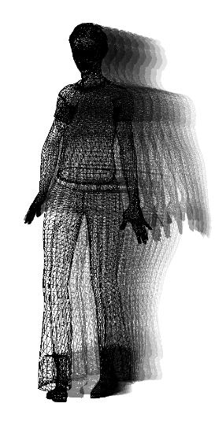
Applications: Mesh Compression
Perceptual metrics for static and dynamic triangle meshes
3D mesh coding
Geometry
  3 floating point coordinates per vertex
Connectivity
  ~3 incident vertices per triangle
(Time)
  new geometry information in each frame
Large amount of storage space required
static mesh ~288 bits per vertex
dynamic mesh >96 bits per vertex and
frame (constant connectivity)
    unless we compress it…
Motivation – Perception – Metrics – Evaluation – Applications
Notes:
Encoding a static or dynamic mesh requires a lot of storage space; that is why compression is important.

Slide 43
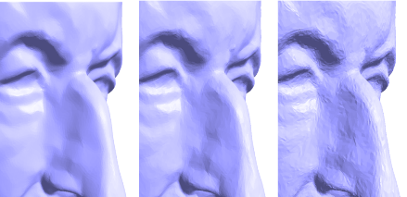
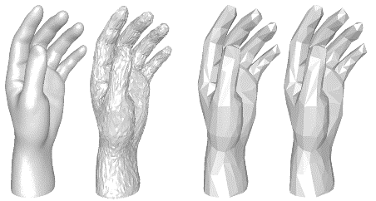
Design optimisations
  Contrast sensitivity function
    [Sorkine et al., 2003]
    Coordinates first transformed by Laplacian matrix, then quantised.
    Errors move to low frequencies, where they are less perceivable.
    [Lee et al., 2012] [Valette et al. 2009]
    Progressive algorithm
    Quantization more aggressive on coarse levels of details
    First LoD →low frequency distorsion
    Lots of work for watermarking
Motivation – Perception – Metrics – Evaluation – Applications
Notes:
Some compression methods integrate the contrast sensitivity function (e.g. quantization noise is concentrated on low frequencies), in order to improve their performance.

Slide 44
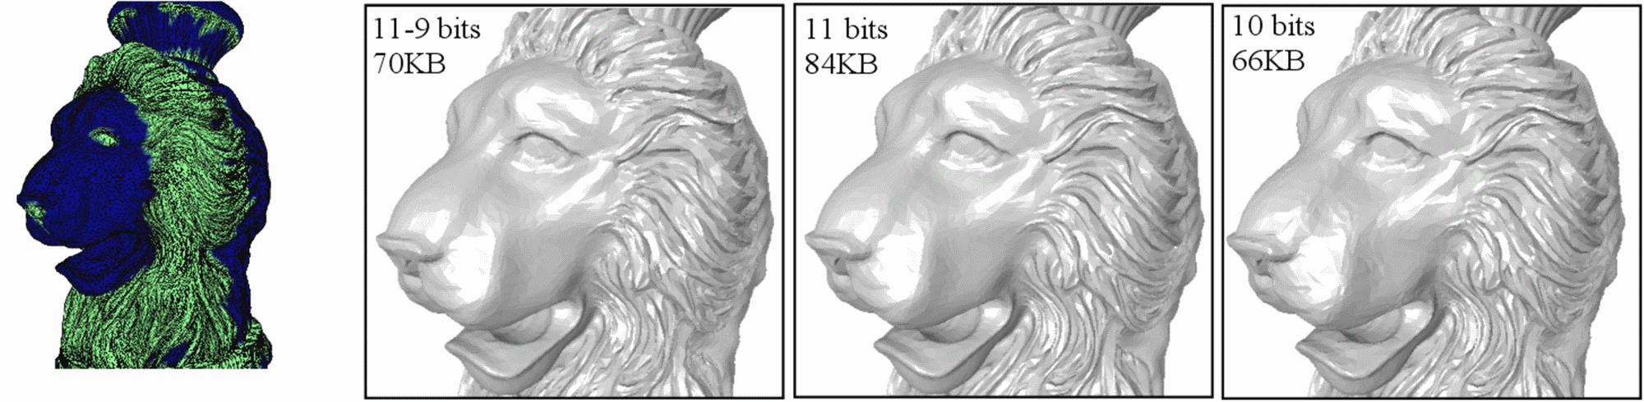
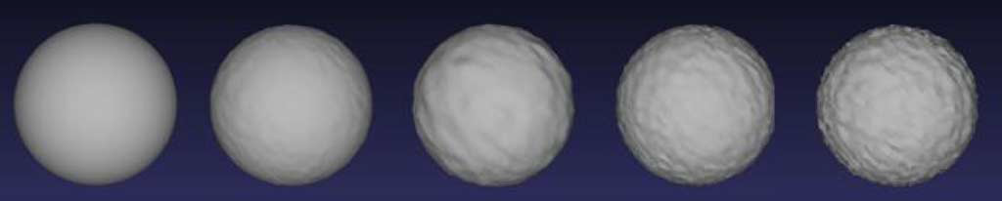
Design optimisations
  Masking
    [Lavoué 2009] - Quantization more agressive on rough areas
    [Kim et al. 2010] - Watermarking more agressive on rough areas
Motivation – Perception – Metrics – Evaluation – Applications
Notes:
Some compression and watermarking methods also make use of the visual masking effect.
They concentrate the artefacts on rough regions.

Slide 45
Configuration optimisations
  Goal: Optimizing the rate-distortion trade-off using a metric
Several works with non-perceptual metrics
[Payan et al. 2006] [Tian and AlRegib 2010]
Example from [Vasa and Petrik 2011]
Configuration optimisation
  Brute-force approach
    trying all possible configurations and
    selecting the best ones
  Iterative approach
  Principle of Equal Slopes
  significantly faster than brute-force
  (polynomial vs. exponential)
  some restrictions on the algorithm
Motivation – Perception – Metrics – Evaluation – Applications
Notes:
Perceptual metrics may also be used to optimize the rate distortion performance of compression algorithms.

Slide 46
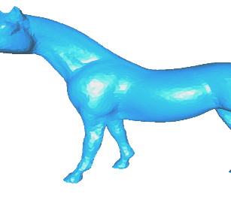
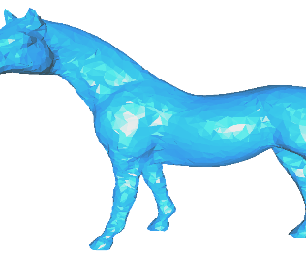
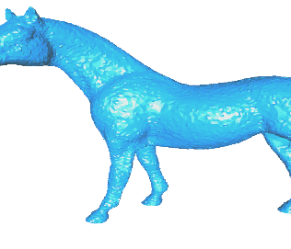
Evaluation - Benchmarking
  Warning! Comparison with classical metrics may not be relevant
  → Need of new benchmarks and public quality metrics
  Wavemesh [Valette and Prost, TVCG 2004]
  Octree [Peng and Kuo, Siggraph 2005]
  Iterative Parametric Refinement [Valette et al., SGP 2009]
RMS distortion
MSDM2 distortion
Motivation – Perception – Metrics – Evaluation – Applications
Notes:
Of course, perceptual metrics provide an alternative, closer to the human visual perception, to traditional distortion metrics like RMS or Hausdorff distance for evaluating compression, simplification or watermarking.
This kind of perceptual performance evaluation produces more relevant results than with classical error measure.

Slide 47
Evaluation - Benchmarking
  Warning! Comparison with classical metrics may not be relevant
  → Need of new benchmarks and public quality metrics
  Different dynamic mesh compression algorithms
Motivation – Perception – Metrics – Evaluation – Applications
Notes:
Of course, perceptual metrics provide an alternative, closer to the human visual perception, to traditional distortion metrics like RMS or Hausdorff distance for evaluating compression, simplification or watermarking.
This kind of perceptual performance evaluation produces more relevant results than with classical error measure.

Slide 48
Take home
When proposing an algorithm that changes mesh geometry
  Is it desirable to reduce the visibility/perceptibility of the change?
In that case
  Do not use MSE, Hausdorff, KG-error etc., they do not correlate with human perception
  See if you can use a better metric (MSDM2, FMPD, STED), they are all available online.
For the future?
  What about colors, textures…
  Machine learning could help?
  Perceptual mechanisms could be more deeply studied regarding 3D.
Motivation – Perception – Metrics – Evaluation – Applications

Slide 49
Merci!
M. Corsini, M-C Larabi, G. Lavoué, O. Petřík, . Váša, K.Wang
Perceptual metrics for static and dynamic triangle meshes
Computer Graphics Forum, vol. 32, No. 1, pp. 101-125, 2013.

