Slide 1


Satellite Data Fusion and Mining for Environmental Monitoring and Decision Making: Challenges and Perspectives
Ni-Bin Chang, Sanaz Imen, Kaixu Bai
Department of Civil, Environmental, and Construction Engineering, University of Central Florida

Slide 2
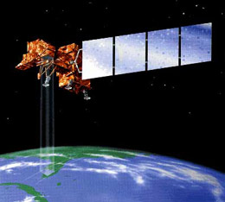
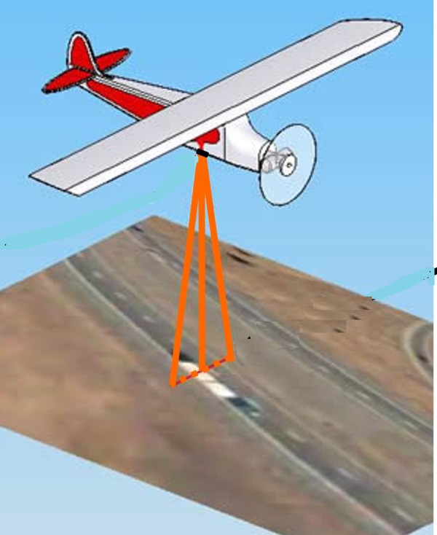
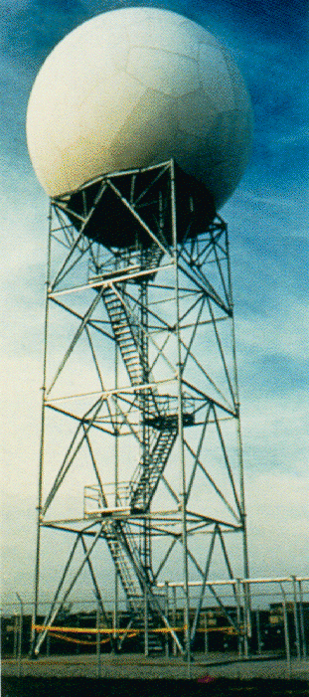
Introduction DATA FUSION DATA MINING CHALLENGES and OPPORTUNITIES FINAL REMARKS
Remote Sensing:
Sensors and Platforms
What is Remote Sensing?
Remote sensing is defined as the
acquisition,
processing,
and interpreting
of images that are remotely obtained from sensors recording the interaction between electromagnetic energy and the Earth’s surface
Remote Sensing Platforms:
Ground-based
Airplane-based
Satellite-based

Slide 3
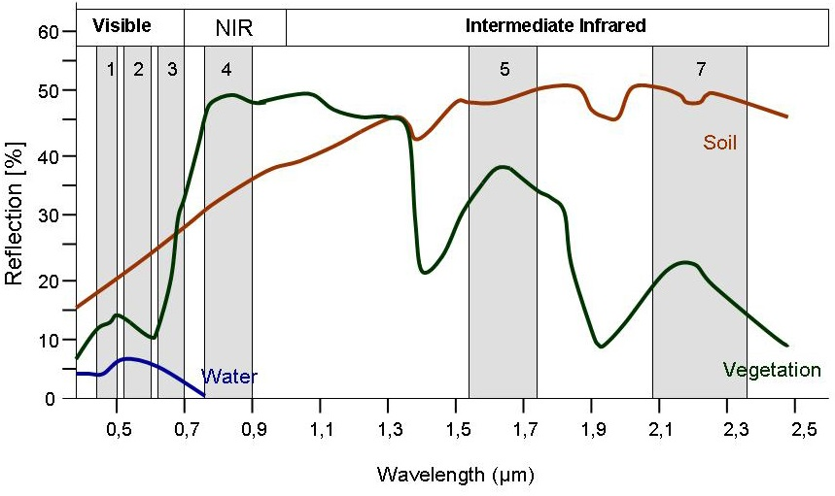
Introduction DATA FUSION DATA MINING CHALLENGES and OPPORTUNITIES FINAL REMARKS
Remote Sensing:
Sensing and Monitoring
Spectral Reflectance Curves
How can surface reflectance quantify water quality parameters?
The amount of radiation that is emitted and reflected from an object is a function of wavelength
Thus, materials can be identified based upon their unique spectral patterns
Landsat band data can be used to identify and differentiate between materials

Slide 4
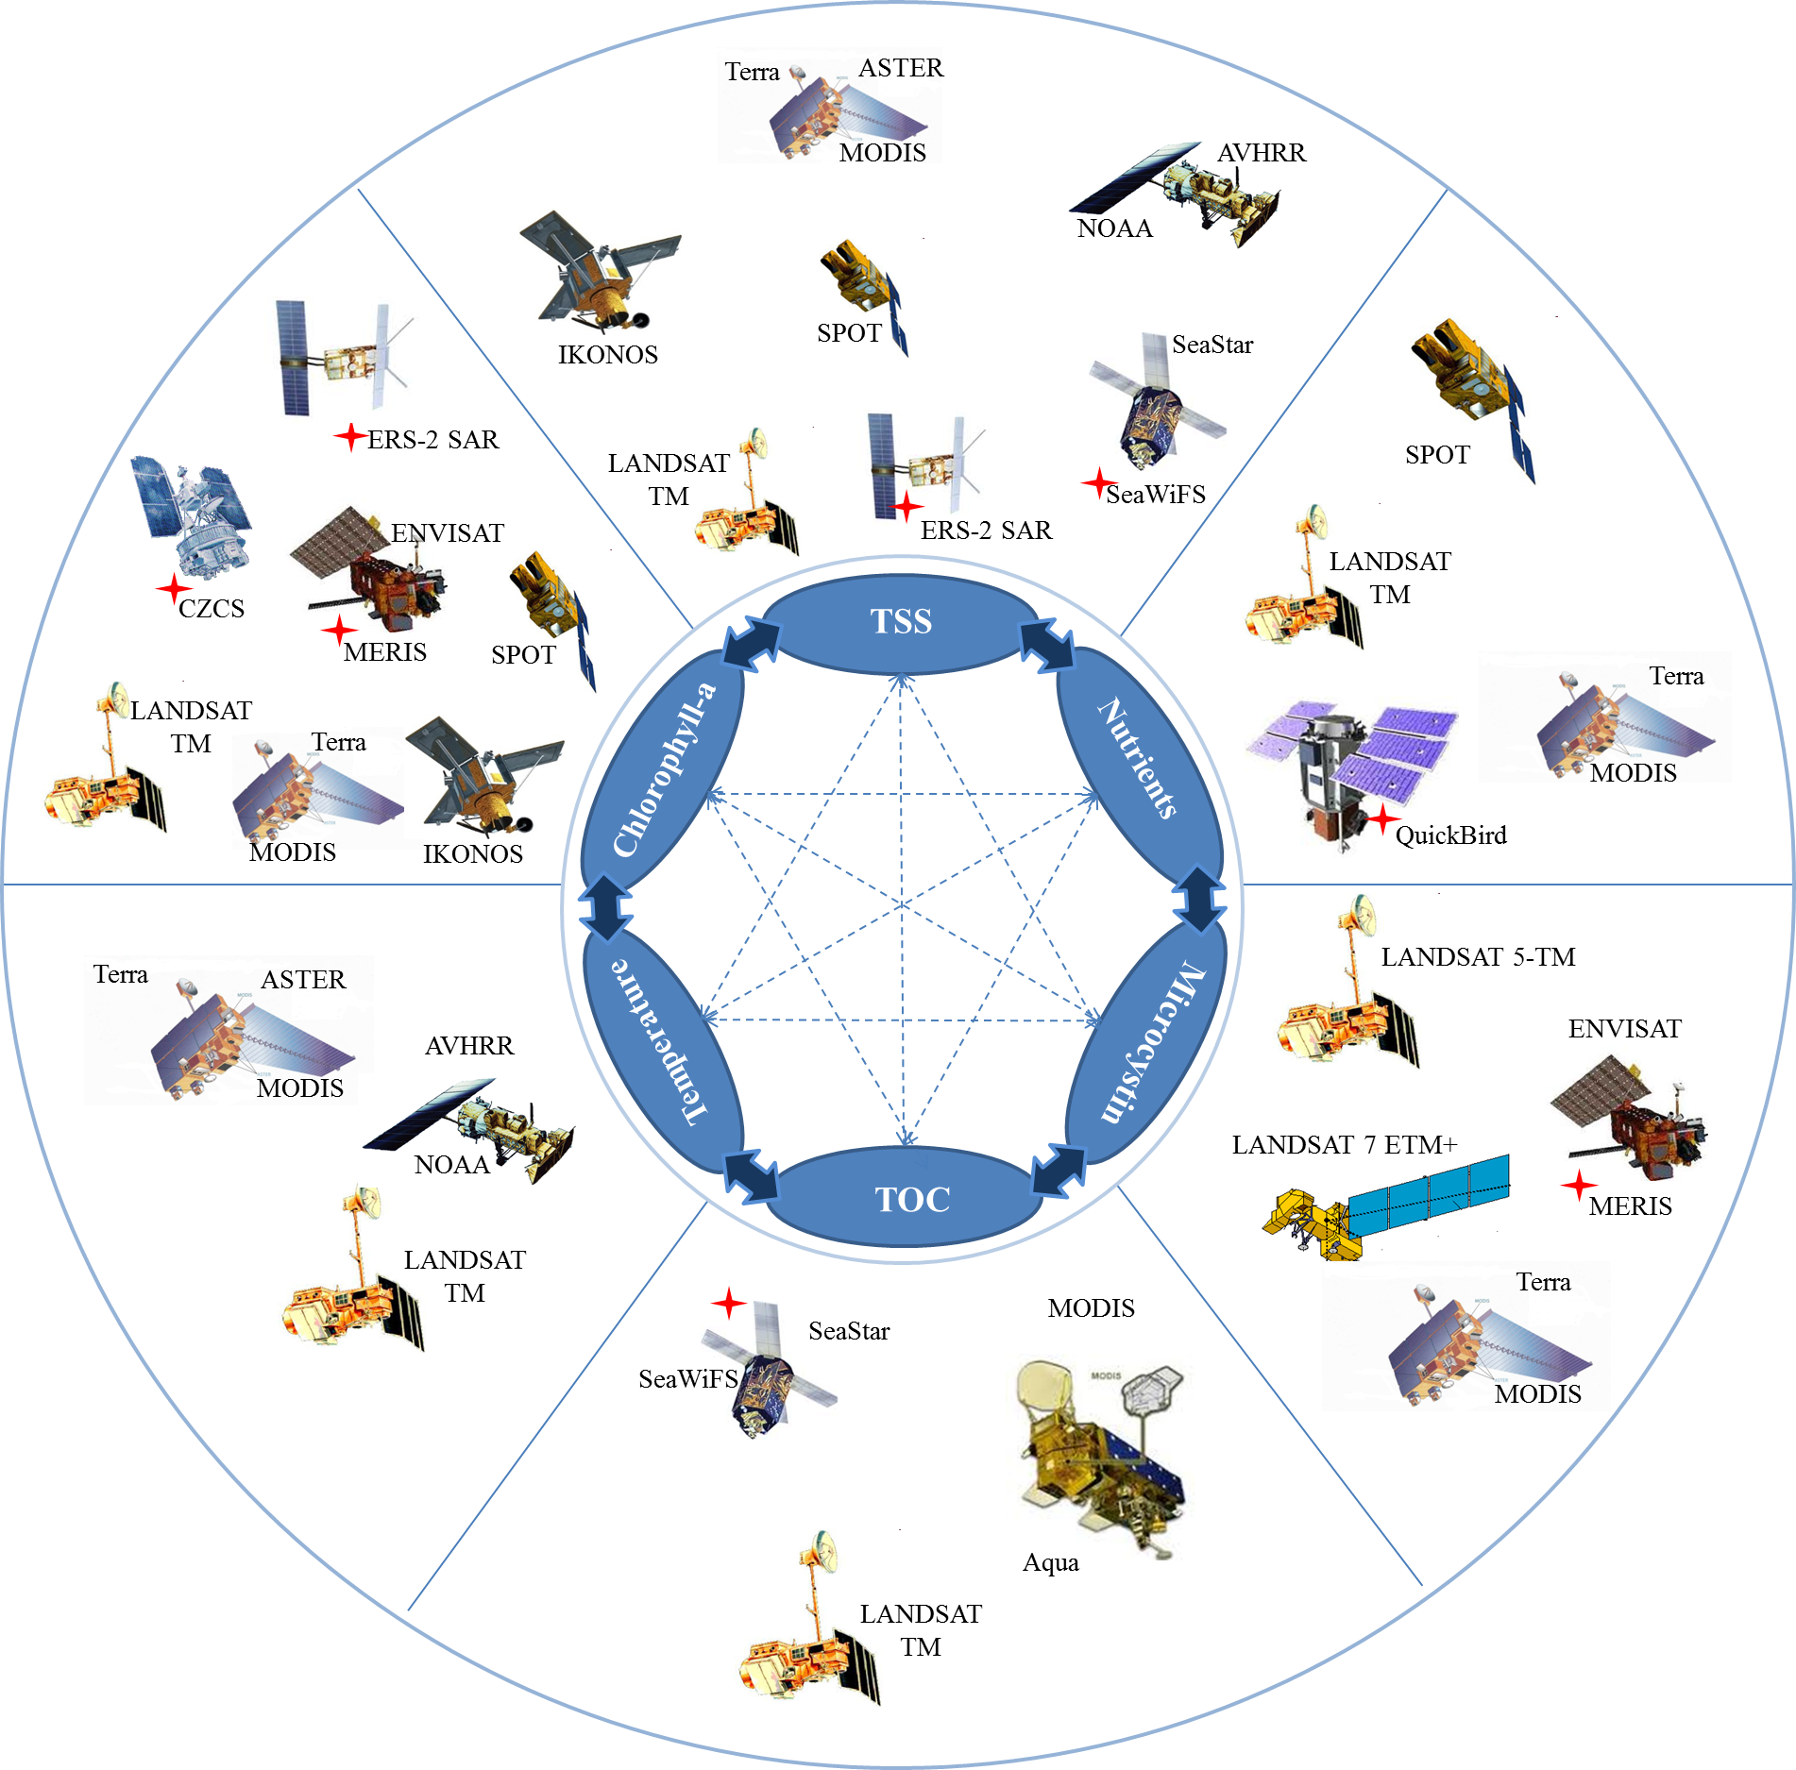
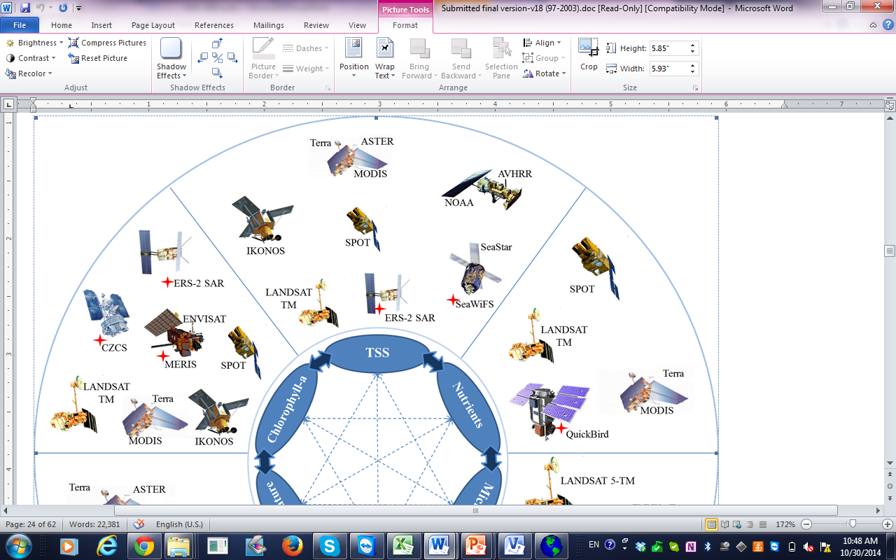
Assessment metrics and associated satellites for monitoring different water quality constituents
satellite is no longer in an active use

Slide 5
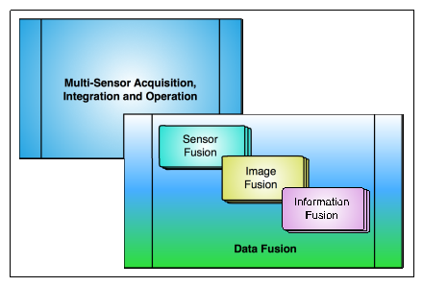
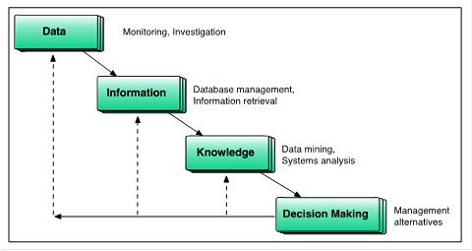
Relevant terminologies of data fusion
Data collection, knowledge discovery and decision analysis sequence

Slide 6
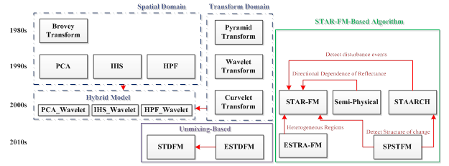
Introduction DATA FUSION DATA MINING CHALLENGES and OPPORTUNITIES FINAL REMARKS
The chronological order of different types of image or data fusion methods

Slide 7
Introduction DATA FUSION DATA MINING CHALLENGES and OPPORTUNITIES FINAL REMARKS
Data Fusion Methods in the 1980s and the 1990s
Method | Advantage | Disadvantage
PCA | Able to merge all bands at one time. Enhance spatial resolution. | Distortion the of the original spectral information. Causes significant color distortion.
IHS | No need to radiometric corrections or radiometric enhancements Enhance spatial details of the multi-spectral images and improve the textural characteristics of the fused images. | Distortion of the original spectral information Based on the conversion of only the color values (RGB).
Brovey Transform | Increase the contrast in the low and high ends of an images histogram. Suitable to produce RGB images with higher degree of contrast. | Should not be used if keeping the original scene radiometry is important. Causes major changes to the statistical parameters of the original images. Cause change in the colors of the original images.
HPF | Least distortion of the spectral characteristics. Keep the low frequency components of TM bands and high frequency components of SPOT bands. It can improve spatial details of the multispectral images. | Find one optimal filter for various ground cover types is difficult or even impossible. Contaminated with serious noise.

Slide 8
Introduction DATA FUSION DATA MINING CHALLENGES and OPPORTUNITIES FINAL REMARKS
Data Fusion Methods in the 2000s
Method | Advantage | Disadvantage
Pyramid Method | Using Laplacian pyramid is considered to reduce image noises Each pyramid level in Laplacian pyramid appeared to produce only one bandpass signal, which made applying multi-resolution scheme to the LP less complicated. Modified version of Laplacian pyramid can minimize the image noise. | Provide an ‘‘over completed representation’’ of the original image.
Wavelet Transform | Able to characterize the local variance at different scales. It has the least distortion of the spectral characteristics. Conserves the spectral fidelity of Landsat TM. | Discards low frequency component of the panchromatic image completely. Causes some ringing effects or degradation of multi-spectral information.
Curvelet Transform | It delineates edges smoothly in two-dimensional platform More capable to fulfill denoising in matching edges from images Shows a greater spectral quality compared with IHS and Wavelet methods | Required more complicated computational effort than other methods

Slide 9
Introduction DATA FUSION DATA MINING CHALLENGES and OPPORTUNITIES FINAL REMARKS
Data Fusion Methods in the 2010s
Method | Advantage | Disadvantage
HIS-Wavelet PCA-Wavelet | Enhance the spatial details and keep the spectral information of the multi-spectral image. Keeps more localized feature information compare to the classical wavelet fusion method. | Compare to fused image produced by PCA or wavelet, the resulted images of the combined method is inferior in correlation coefficient and deviation index.
Wavelet-PCA
STAR-FM | Able to record the transition from one state to another. | Cannot predict disturbance events Any changes that are too subtle to be observed by the MODIS observations are not predictable with this algorithm. STARFM method does not explicitly handle the directional dependence of reflectance. Apply LSR images to estimate change or change trend.
Semi-Physical Fusion Approach | It does not require any tuning parameters. Not affected by the missing or contaminated neighboring Landsat pixels. | Scale discrepancy
Unmixing-based data fusion | Reconstruct images with a high spectral fidelity. It can be applied even if the low resolution image only has mixed pixels. | Number of components that can be unmixed is limited by the number of spectral bands of the image. It requires a high resolution land-use database for pixel unmixing.
STAARCH | More capable in detecting the spatial and temporal changes in the landscape. | It has the same problem as STARFM for heterogeneous regions. Prediction results degrade somewhat when used on heterogeneous fine-grained landscapes. Its ability in detecting landscape disturbance is limited to specific types of land-cover change.

Slide 10
Introduction DATA FUSION DATA MINING CHALLENGES and OPPORTUNITIES FINAL REMARKS
Classification
Which inversion model?
One of challenges in environmental monitoring by remote sensing is associated with selecting a suitable inversion method to find the strong relationship between water quality parameters and remotely sensed data.
1. Empirical Methods
2. Analytical Methods
3. Semi-Analytical/Semi-Empirical Methods

Slide 11
Introduction DATA FUSION DATA MINING CHALLENGES and OPPORTUNITIES FINAL REMARKS
Selected analytical methods applied to retrieve water quality parameters from remotely sensed data
Remote Sensing Platforms | Location | Method
Compact Specrographic Imager (CASI) | Lake Braassem, Netherlands | MIM
CZCS | Mediterranean Sea | Purely Analytical Method
MOS (Phase-I) SeaWiFS (Phase II) | North Sea | Analytical Inversion of an Optical Model
Landsat 5 TM and SPOT-HRV | Southern Frisian Lakes, Netherlands | Forward and Inverse bio-optical modeling
SPOT and Landsat TM | 14 Frisian Lakes, Netherlands | Analytical Optical Modeling
EO-1(Hyperspectral Hyperion Data) | Moreton Bay, Australia | MIM
Landsat 7 ETM | Moreton Bay, Australia | Analytical Model of Underwater Light Climate
EO-1 (Hypespectral Hyperion Data) | Lake Garda, Italy | MIM
Airborne Visible Infrared Imaging Spectrometer (AVIRIS) | Hudson/Raritan Estuary, New Jersey, U.S. | Bio-optical Model

Slide 12
Introduction DATA FUSION DATA MINING CHALLENGES and OPPORTUNITIES FINAL REMARKS
Selected semi-empirical or semi-analytical methods applied to retrieve water quality parameters from remotely sensed data
Remote Sensing Platforms | Location | Method
CASI and CESAR | Northern Vecht Lakes, Netherlands | Semi-Empirical Method
SeaWiFS | Bedform Basin, Canada | Semi-Analytical Model
Landsat TM and simulated SeaWiFS | Gulf of Finland | Semi-Empirical Algorithm
SeaWiFS | - | Semi-Analytical Garver-Siegel-Maritorena (GSM) Model
Hyperspectral airborne casi and HyMap | Mecklenburg Lake Dirstrict, Germany | Semi-Empirical Multi-sensor and Multi-temporal Approach
SeaWiFS MODIS | South Pacific Region (Marquwsas Islands) | Semi-Analytical Model-based Ocean Color Merging Approach
Hyperspectral Coupled Ocean Dynamics Experiments (HyCODE) | Mid-Atlantic Bight-U.S. | Semi-Analytical Inversion Model
SeaWiFS | UK shelf seas and NE Atlantic Ocean | Semi-Analytical IOP (Inherent Optical Properties) Model
ASD FieldSpec UV-VNIR | Geist and Morse Resevoirs-Indiana-U.S. | Semi-Empirical Remote Sensing Method
MERIS, ASTER, Airborne Hyperspectral Spectrometer(AHS) | Vecht and Veluwe lakes, Netherlands | Semi-Analytical IOP
MODIS | Southern Beaufort Sea | Semi-Analytical Method
MODIS | Gulf of Gabes, Libya | Semi-Empirical Method

Slide 13
Introduction DATA FUSION DATA MINING CHALLENGES and OPPORTUNITIES FINAL REMARKS
Selected empirical and hybrid methods applied to retrieve water quality parameters from remotely sensed data
Remote Sensing Platforms | Location | Method
ADEOS/OCTS | South of Honshu, Sea of Japan, Tokyo Bay, Sagami Bay, Japan | Statistical Regression
Landsat TM | Delaware Bay, U.S. | Artificial Neural Network
SPOT | Yeong-Her-Shan Reservoir, China | Genetic Programming
Landsat TM | Beaver Lake, U.S. | Radial Basis Function Neural Network Models ( RBFN)
Landsat TM | Beaver Reservoir, U.S. | Artificial Neural Network
Landsat TM | Poyang Lake, China | Statistical Regression and Artificial Neural Network
Landsat 7 ETM | Feitsui Reservoir, Taiwan | Incorporating Grammatical Evolution in Genetic Algorithm (GEGA)
MODIS | Lake Okeechobee, U.S. | Genetic Programming, Artificial Neural Network, and Multiple Linear Regression
Landsat TM | Taihu Lake, China | Fusion Method (Choquet Fuzzy Integral-CFI)
MERIS VIS/NIR | Baltic Sea | Artificial Neural Network
Landsat TM | Kissimmee River, U.S. | Artificial Neural Network
FieldSpec FR spectroradiometer | Shitoukoumen Reservoir, China | Genetic Algorithms and Partial Least Square (GA-PLS)

Slide 14
Introduction DATA FUSION DATA MINING CHALLENGES and OPPORTUNITIES FINAL REMARKS
Inversion Modeling for Retrieving Water Quality Parameters
The chronological trend of applying inversion methods for monitoring water quality by remote sensing

Slide 15
Introduction DATA FUSION DATA MINING CHALLENGES and OPPORTUNITIES FINAL REMARKS
Inversion Modeling for Retrieving Water Quality Parameters
Application of different inversion methods for monitoring differing water quality constituents

Slide 16
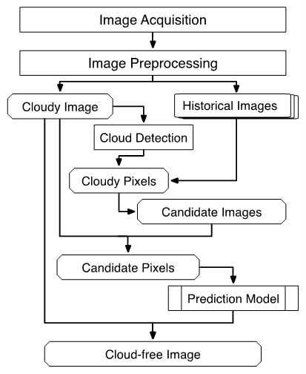
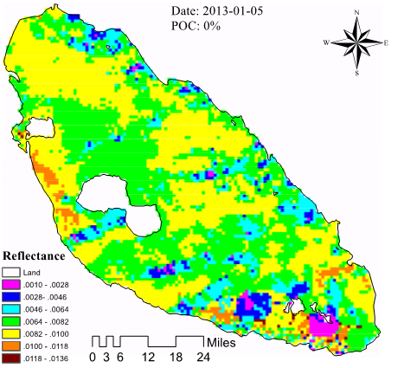
Introduction DATA FUSION DATA MINING CHALLENGES and OPPORTUNITIES FINAL REMARKS
Cloud Contamination Issue
The combination of multiple satellite sensors with different spatial, temporal, and spectral resolution to provide and synergistic effect;
Integration of optical and microwave remote sensing images to provide complementary effect.
Cloud removed with ELM

Slide 17
Introduction DATA FUSION DATA MINING CHALLENGES and OPPORTUNITIES FINAL REMARKS
Data Mining Issue
Data mining or inverse modeling requires using large amount of ground truth data sets to calibrate and validate some of the highly nonlinear semi-empirical and empirical models in supervised learning to improve the prediction accuracy.
This complexity made such a system unable to be operational in various emergency response conditions
But this demands a long-term effort to build up a global scale database resulting in big data in support of the decision making in emergency response events.

Slide 18
Introduction DATA FUSION DATA MINING CHALLENGES and OPPORTUNITIES FINAL REMARKS
Data Format Issue
When dealing with data fusion, data are oftentimes acquired from different databases with a nonuniform storage format and various processing level instead of from a single sensors and platforms at the same processing extents, storage formats, and acquisition policies.
This will create critical challenges for big data management, big data analytics, or scientific discovery processes impacted by big data to support the data mining and inverse modeling.
These advancements will cover techniques, methodologies and technologies that can be computational, statistical, or mathematical in nature, to focus on novel theoretical analysis or experimental evaluation of these techniques and methodologies.
In any circumstance, a consensus process that encourages development and implementation of open standards for geospatial contents and services is required.

Slide 19
Introduction DATA FUSION DATA MINING CHALLENGES and OPPORTUNITIES FINAL REMARKS
Decision Making Issue
The concept of a "sensor web" that depends on the "Sensor Web Enablement," can improve the provision of alternatives of sensor fusion, image fusion and information fusion.
This was developed by the Open Geospatial Consortium aided by a suite of web service interfaces and communication protocols abstracting from the heterogeneity of sensor communication.
Data management in a worldwide sensor web, with essential support of various semantic modeling of data fusion and annotation of sensor data to aid in data mining, is in an acute need.
the interoperability of web-based models (model web) for satellite data fusion and mining can be in concert with the sensor web.

Slide 20
Introduction DATA FUSION DATA MINING CHALLENGES and OPPORTUNITIES FINAL REMARKS
The thriving research in satellite data fusion and mining have been motivated in unpredictable speed in academic communities.
In the future, a near-real time satellite-based environmental monitoring system that can work in all weather conditions could be in place in support of emergency response.
These types of decision analysis can be applied for improving natural hazard or natural resources management within coupled natural systems and the built environment.

Slide 21
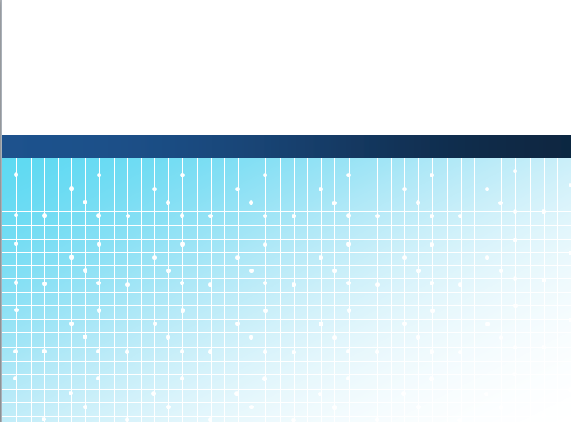

Thank You !
Ni-Bin Chang
nchang@ucf.edu

